Slide 1
Clustering INFO 6105 Assignment 4
Vignesh Gunasekaran, COE @ NEU
Feb 18, 2022

Slide 2
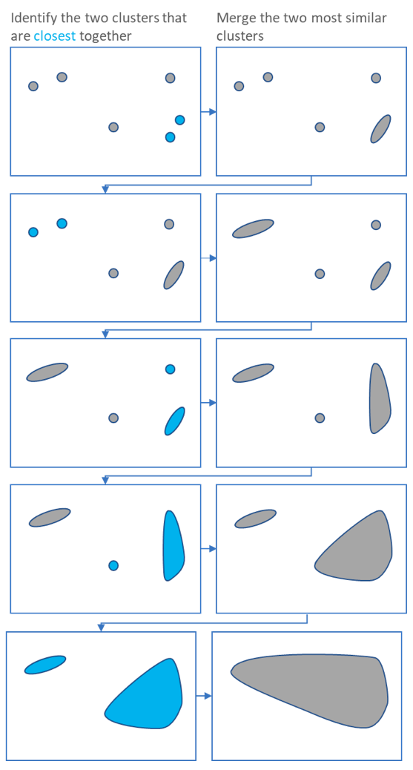
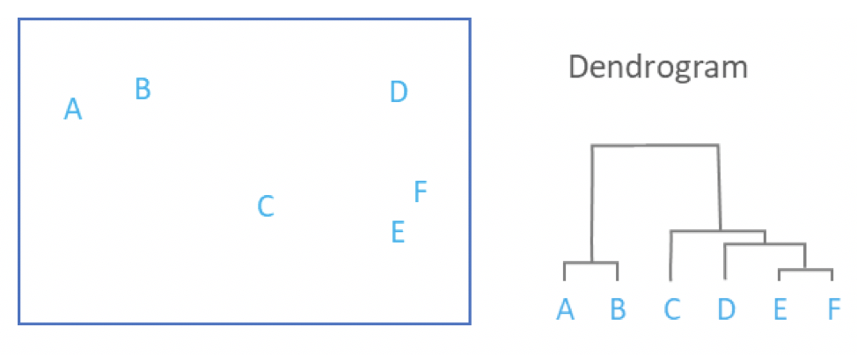
Hierarchical Clustering
an algorithm that groups similar objects into groups called clusters. The endpoint is a set of clusters, where each cluster is distinct from each other cluster, and the objects within each cluster are broadly similar to each other.
It starts by treating each observation as a separate cluster. Then, it repeatedly executes the following two steps: (1) identify the two clusters that are closest together, and (2) merge the two most similar clusters. This iterative process continues until all the clusters are merged together.

Slide 3
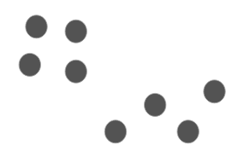
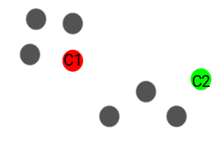
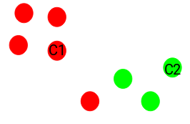
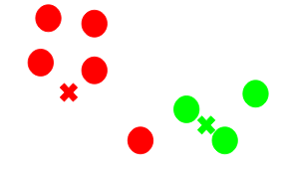
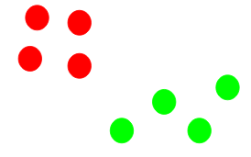
K-means Clustering
K-means is a centroid-based algorithm, or a distance-based algorithm, where we calculate the distances to assign a point to a cluster. In K-Means, each cluster is associated with a centroid.
The main objective of the K-Means algorithm is to minimize the sum of distances between the points and their respective cluster centroid.
Steps: 1: Choose the number of clusters k 2: Select k random points from the data as centroids 3: Assign all the points to the closest cluster centroid 4: Recompute the centroids of newly formed clusters 5: Repeat steps 3 and 4
Stopping Criteria: A. Centroids of newly formed clusters do not change B. Points remain in the same cluster C. Maximum number of iterations are reached

Slide 4
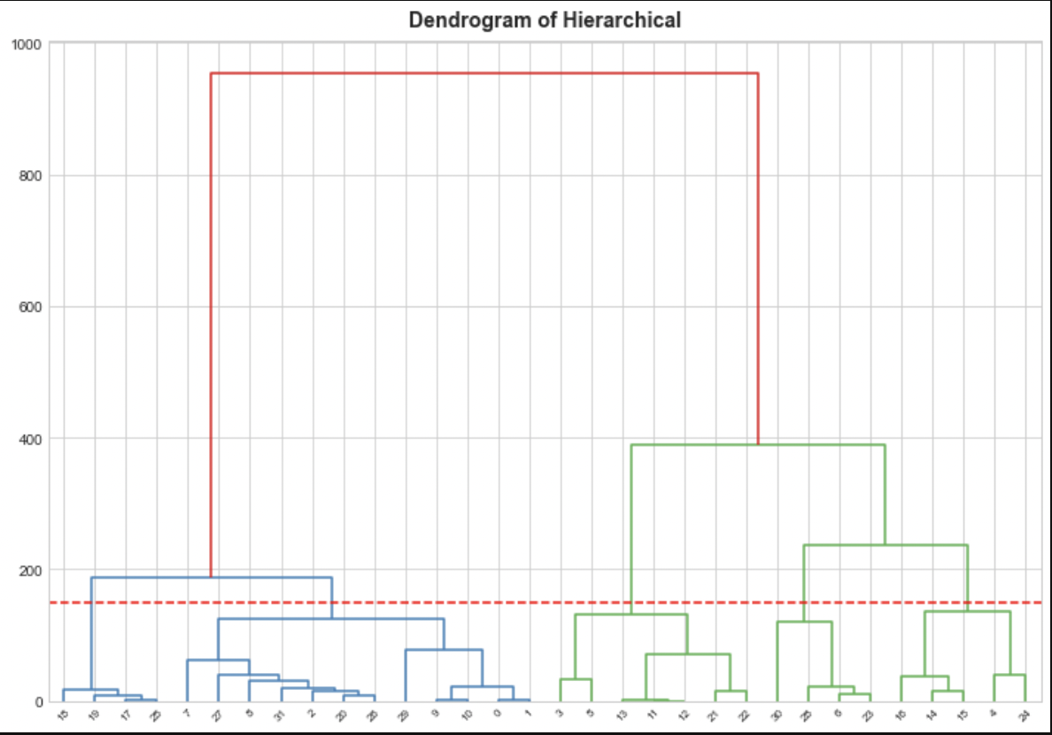
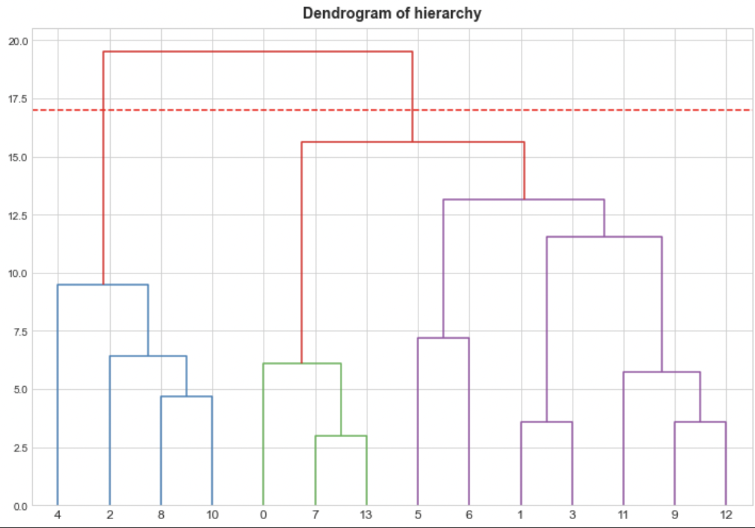
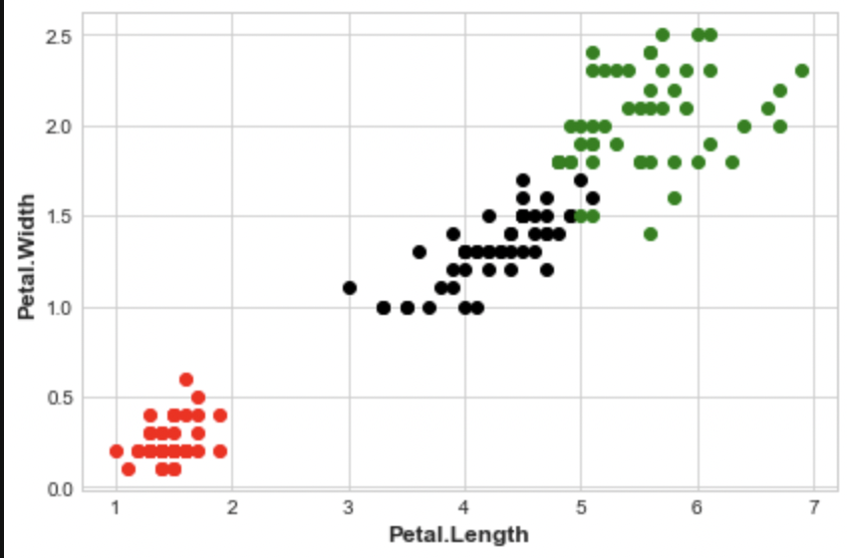
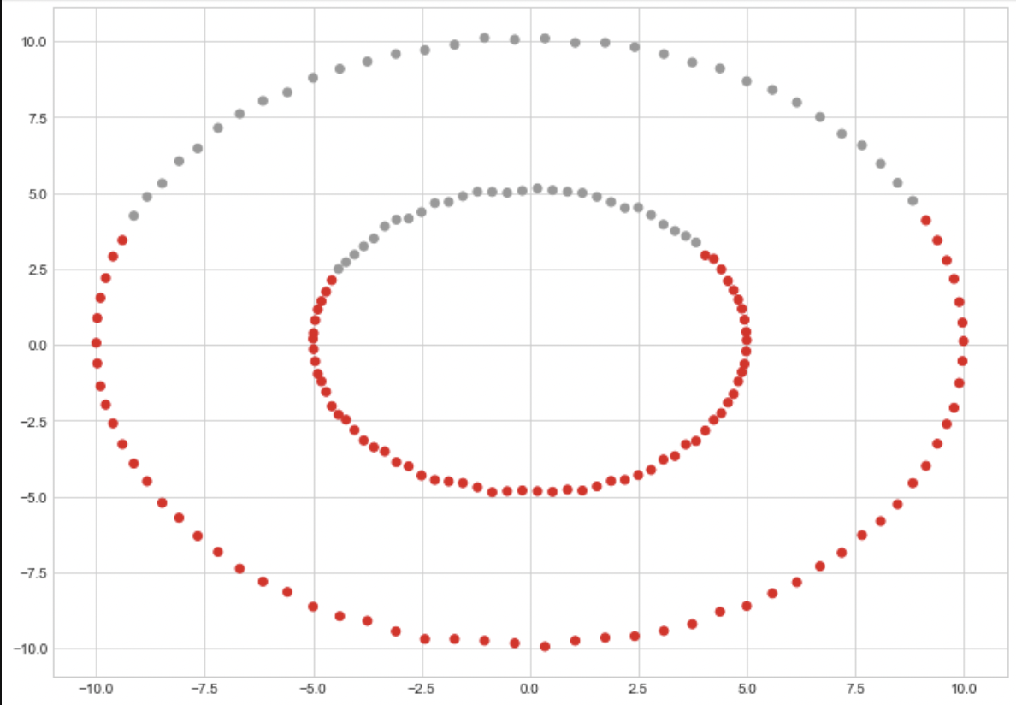
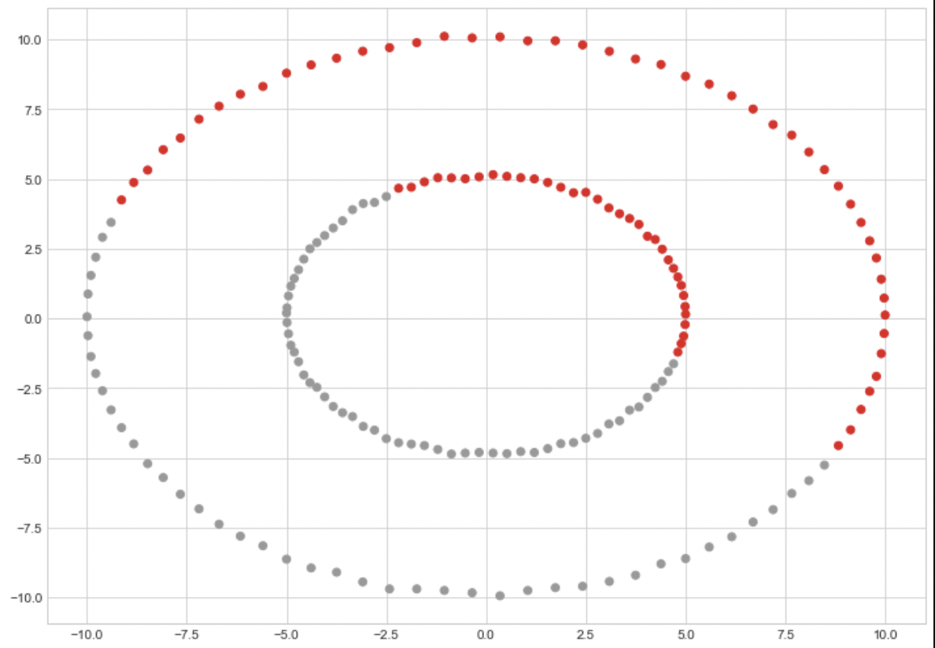
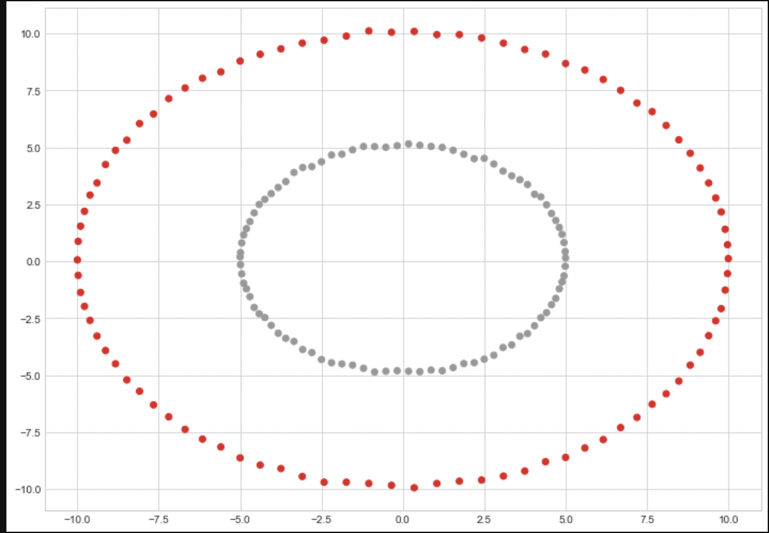
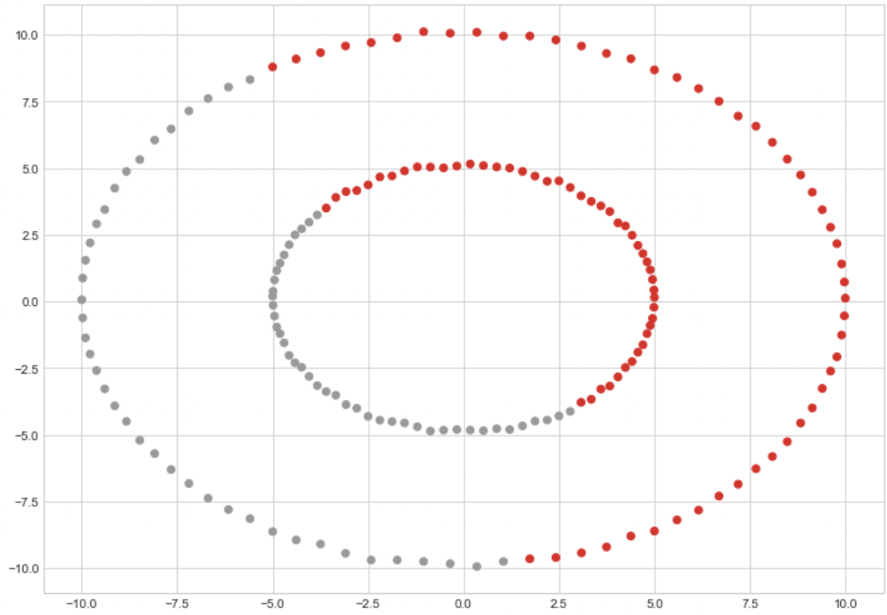
R to Python Problems
2.a K-means + Hierarchical Clustering R-Python
2.c Play Hierarchical:
2.d Iris:
2.b Circles: Complete, Average, Single, Ward resp.

Slide 5
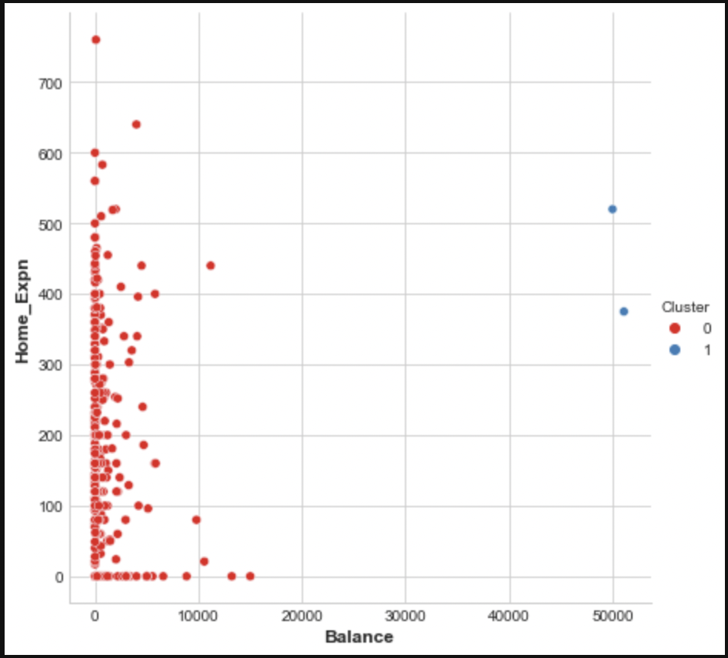
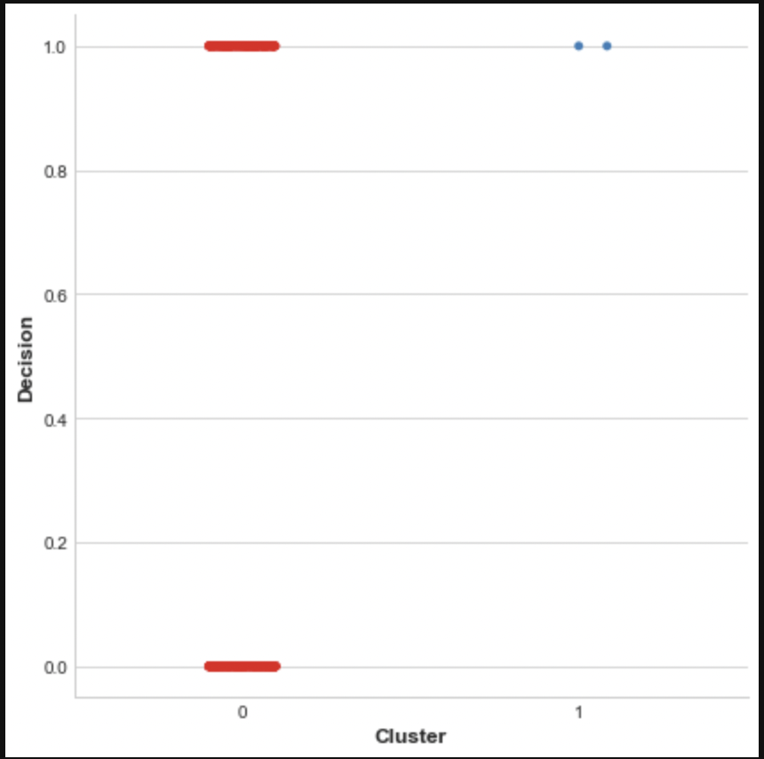
K-Means on Loan dataset
Q.3. Balance vs Home_Expn:
Taken 2 as K value = clusters
Two clusters alignment with accept and reject:

